Slide 1
Capstone Project
Credit Card Default Prediction
Team
Rahul Kumar Soni, Lakdawala Ali Asgar

Slide 2
Content
Introduction
Problem Statement
Data Summary
Approach Overview
Exploratory Data Analysis
Modelling Overview
Feature Importances
Challenges
Conclusion

Slide 3
Introduction
In today’s world credit cards have become a lifeline to a lot of people so banks provide us with credit cards. Now we know the most common issue there is in providing these kind of deals are people not being able to pay the bills. These people are what we call “defaulters”.

Slide 4
Problem Statement
Predicting whether a customer will default on his/her credit card

Slide 5
Data Summary
X1 - Amount of credit(includes individual as well as family credit)
X2 - Gender (1 = male; 2 = female).
X3 - Education (1 = graduate school; 2 = university; 3 = high school; 4 = others)
X4 - Marital Status (1 = married; 2 = single; 3 = others)
X5 - Age(year).
X6 to X11 - History of past payments from April to September
X12 to X17 - Amount of bill statement from April to September
X18 to X23 - Amount of previous payment from April to September
Y - Default payment next month

Slide 6
Pipeline
Data Cleaning
Data Exploration
Modeling
Understanding and Cleaning
Null value analysis
Outlier Treatment
Graphical
Univariate analysis with visualization
Bivariate Analysis
with visualization
Machine Learning
Logistic regression
SVM
Decision tree
Random Forest
XGBoost
CatBoost
Lightgbm

Slide 7
Basic Exploration
Data of 30000 customers.
6 Months payment and bill data.
No null data.
9 Categorical variables present.
Various undocumented/wrong labels were present

Slide 8
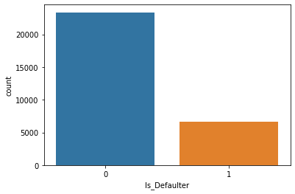
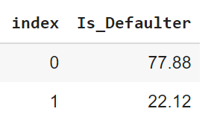
Defaulter Distribution

Slide 9
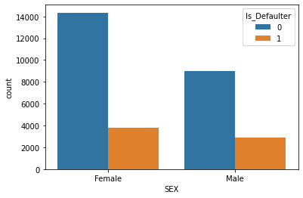
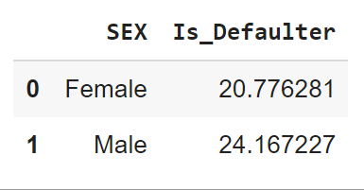
Gender Distribution

Slide 10
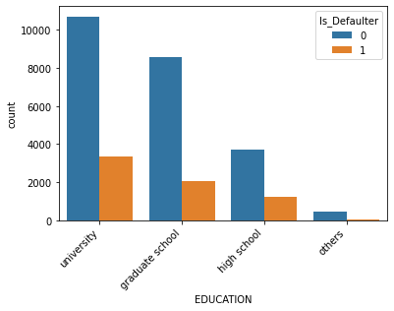
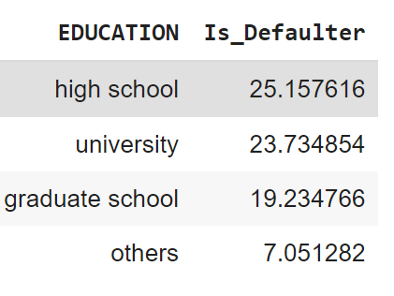
Education Distribution

Slide 11
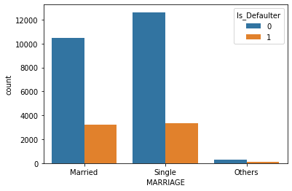
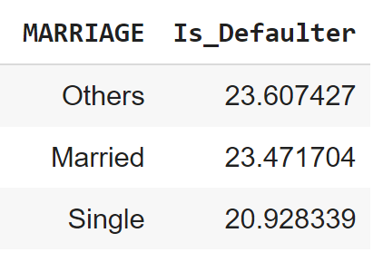
Marital Distributions

Slide 12
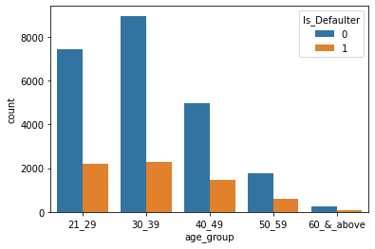
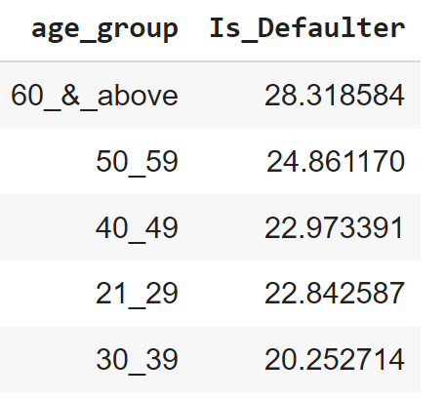
Age Distribution

Slide 13
Modeling Overview
Supervised learning
Binary Classification
Imbalance data with 22% defaulters
Models Used:
Logistic Regression
Decision Trees
Random Forest
SVM
XGBoost
CatBoost
LightGBM

Slide 14
Modeling Steps
Model Evaluation
Data Preprocessing
Data Fitting and Tuning
Feature selection
Feature engineering
Train test data split(75%-25%)
SMOTE oversampling
Start with default model parameters
Hyperparameter tuning
Measure scores on training & test data
Model testing
Compare models

Slide 15
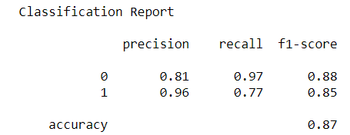
Logistic Modelling
Parameters :
C = 0.01
Penalty = L2

Slide 16
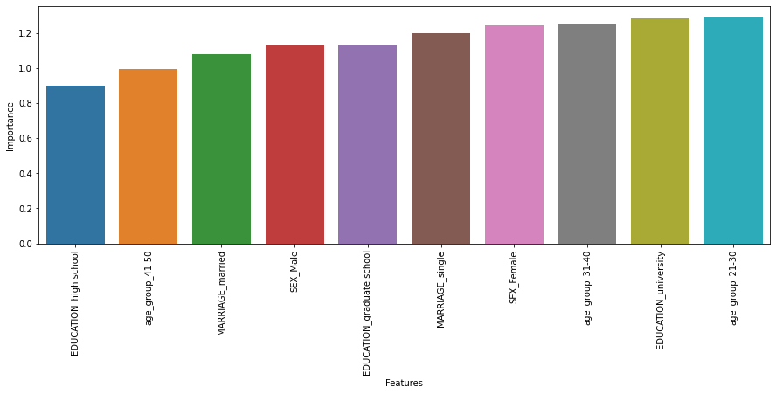
Logistic feature importances

Slide 17
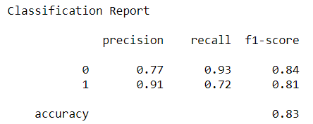
Decision tree
Parameters :
max_depth=10
max_leaf_nodes=45
criterion= Entropy

Slide 18
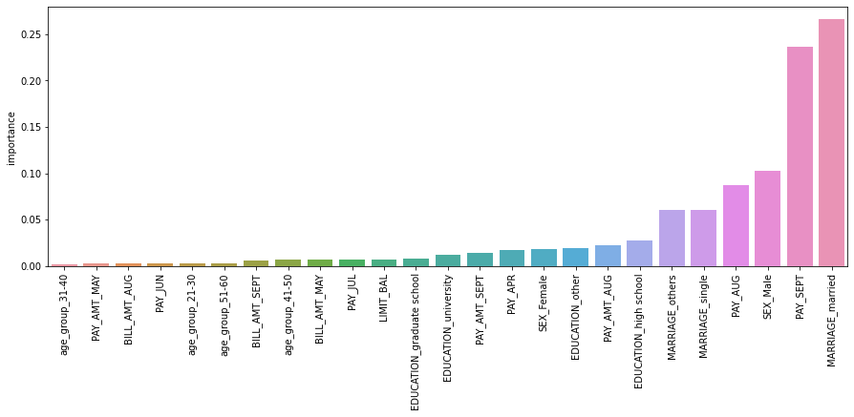
Decision tree feature importances

Slide 19
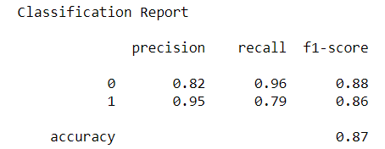
SVM Modelling
Parameters
C = 10
Kernel = ‘rbf’

Slide 20
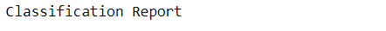
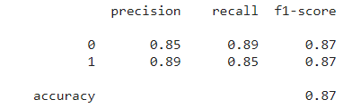
Random Forest Metrics
Parameters :
max_depth=9
n_estimators=200
criterion: entropy

Slide 21
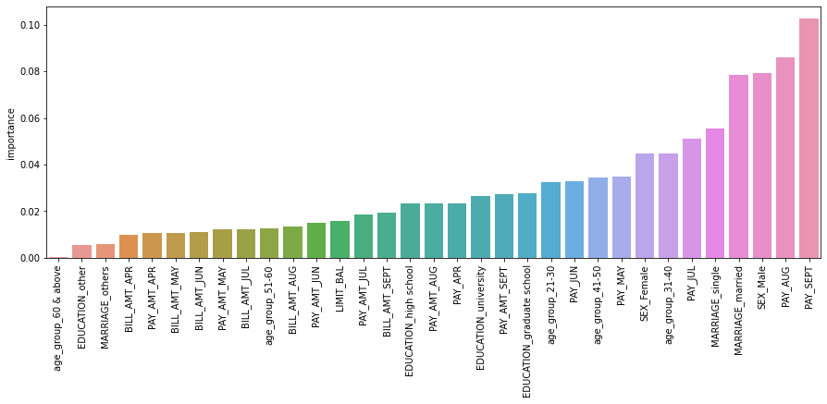
Random Forest feature importances

Slide 22
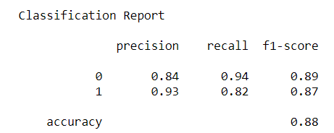
XGBoost Modelling
Parameters :
max_depth= 9
n_estimators=150

Slide 23
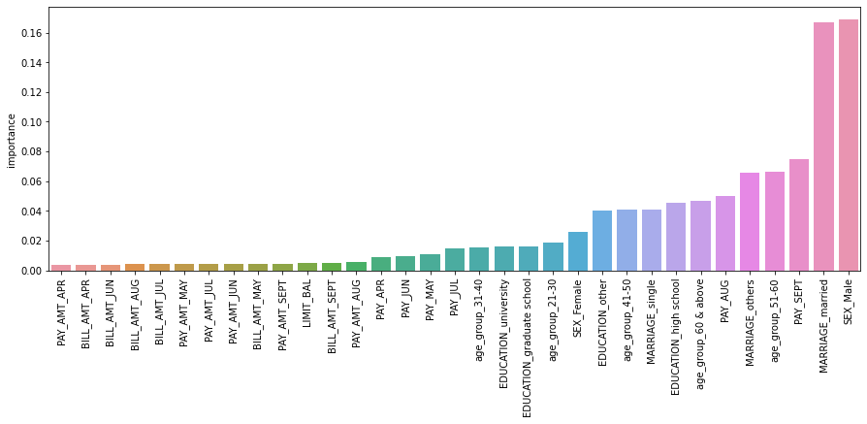
X Gradient Boosting feature importances

Slide 24
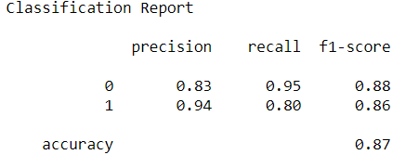
CatBoost
Parameters :
max_depth=3,
n_estimators: 150

Slide 25
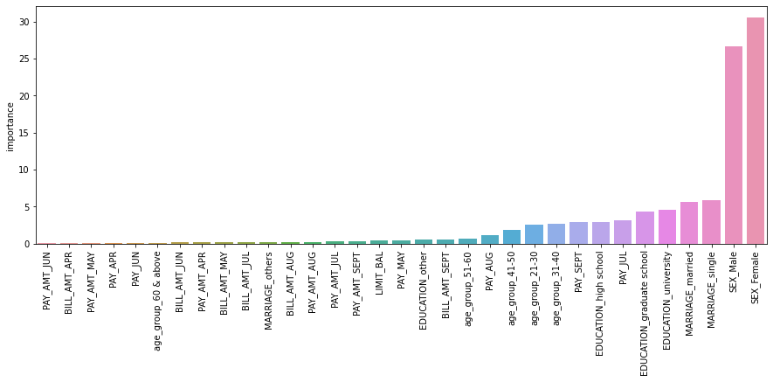
CatBoost feature importances

Slide 26
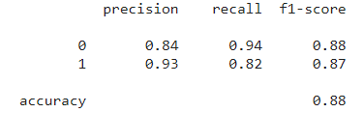
LightGBM
Parameters :
max_depth=7
n_estimators: 150

Slide 27
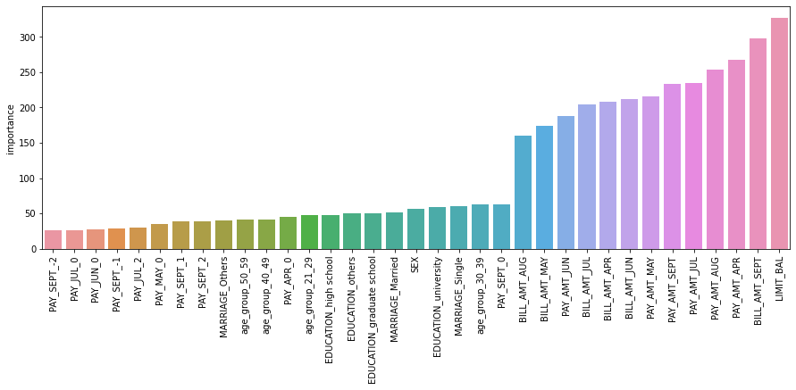
LightGBM feature importance

Slide 28
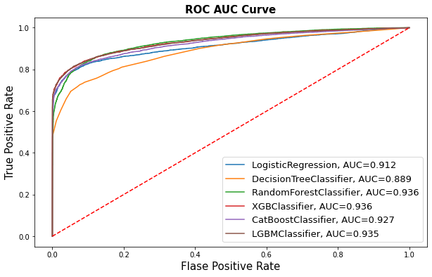
AUC-ROC curve comparison

Slide 29
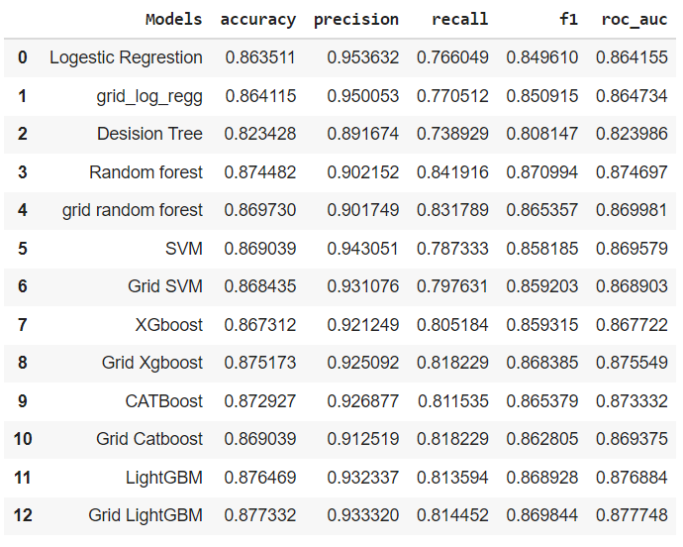
Score Matrix

Slide 30
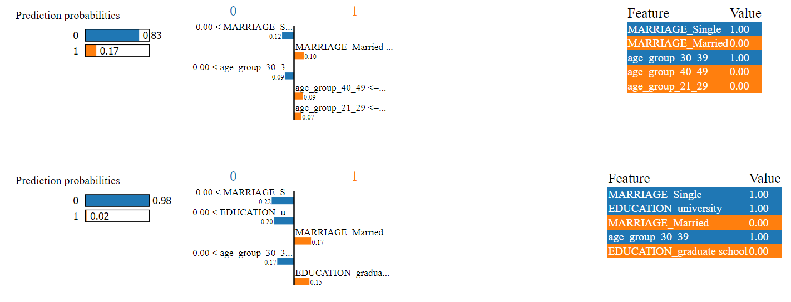
Model Explainability - LIME
Random forest
XGBoost

Slide 31

Challenges
Understanding the columns.
Feature engineering.
Getting a higher recall on the models.

Slide 32

Conclusion
The default rate is higher for males, increases as the education increases, also increases as the age of a person increases. i.e clients whose age over 60 was higher than mid-age and young people.
In all of these models, our recall revolves in the range of 76 to 84%.with the best fit model as random forest

Slide 33
Thank You

